Slide 1
Seismic Enigmata of Cascadia
Paul Bodin
Pacific Northwest Seismic Network

Slide 2
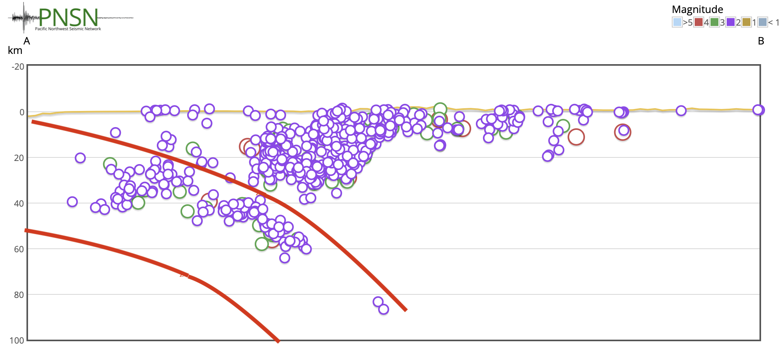
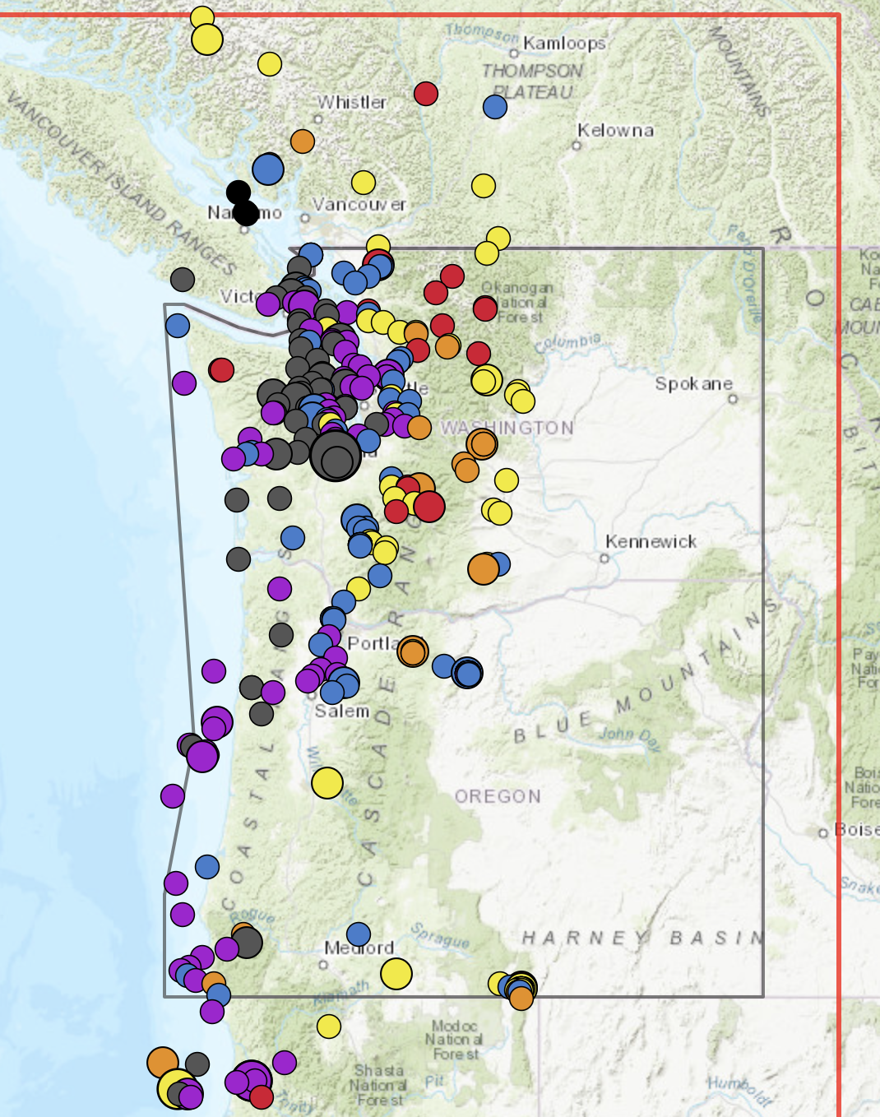
Microseismic enigmata — a short list
Lack of Interface seismicity
Except tremor
Dearth of Intraplate aftershocks (in light of Alaska & Mexico EQs)
Quietness of central Cascadia
Depth of Puget Sound earthquakes
& the location and activity of the Seattle Fault at depth
Crustal swarms

Slide 3
Macroseismic & Process Questions
Role of fluids
Coupling/’Locking’ of Interface
Interaction of crustal faults with plate interface
State of stress throughout SZ
Intraplate, surrounding interface, crustal, at triple junctions…
Role of materials (geology & rock type)
Role of physical conditions
Possibility of Tsunami earthquakes
In general, the kinematics and dynamics of interface ‘quakes.

